Slide 1
My Learning Experience in the Past Four Weeks
Excel, Azure DevOps, and Database Design
Ogochukwu Ebele

Slide 2
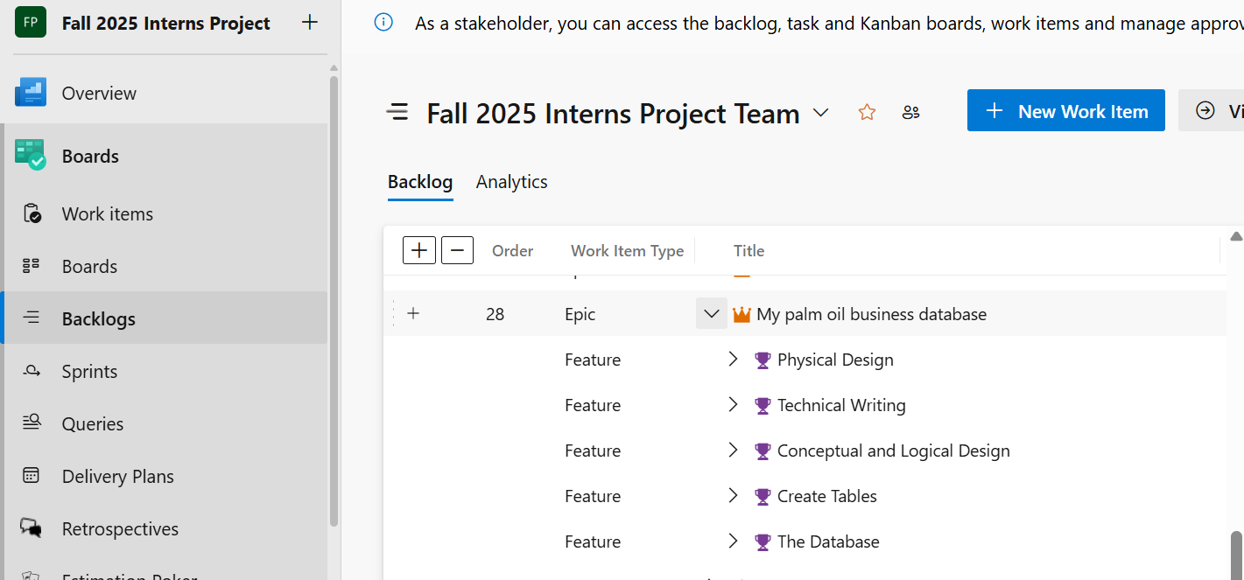
Azure DevOps Experience
Azure DevOps Experience
Bullet points:
Working on Azure DevOps interface with team members
Breaking down projects into smaller tasks
Creating epics, features, and PBIs
Shuffling tickets on the board and committing to sprints
Completing tasks and closing them

Slide 3
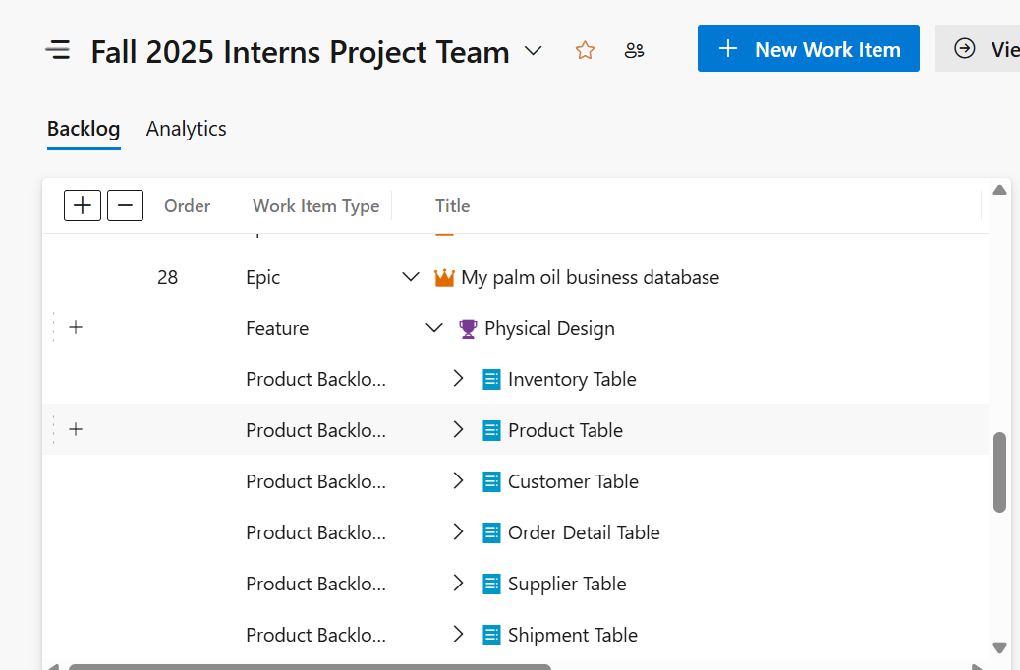
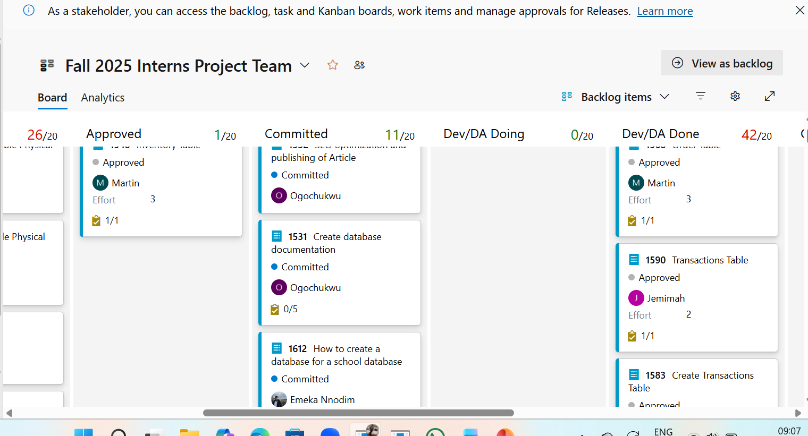
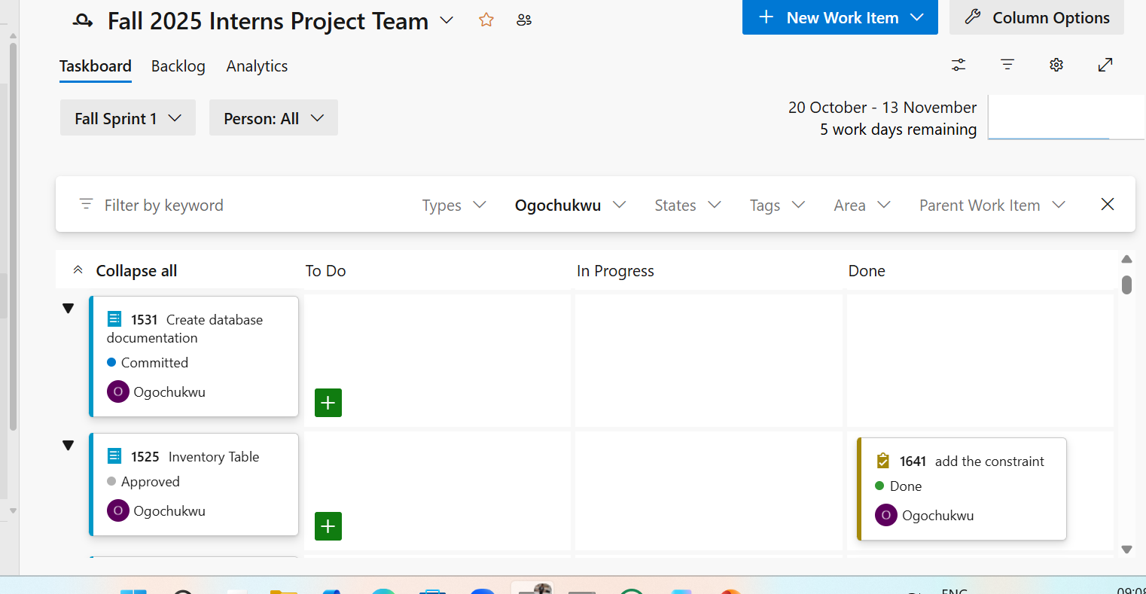
Screenshots Of Azure DevOps Experience

Slide 4
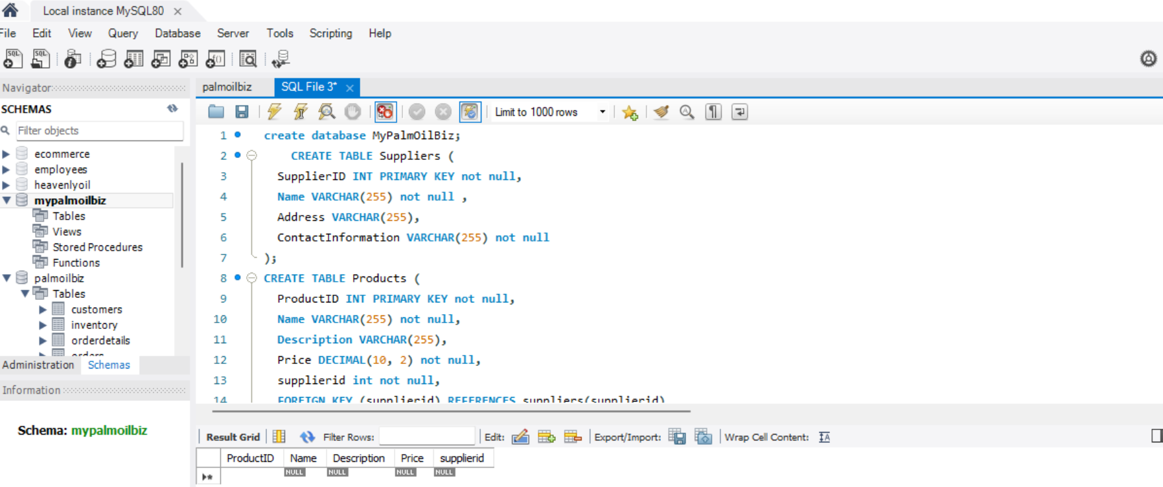
Database Design Project
Database Design Project
Bullet points:
Designing a palm oil database
Gathering entities and relations
Creating ERD on Lucid Chart
Implementing database on MySQL Workbench
Writing articles on database design steps

Slide 5
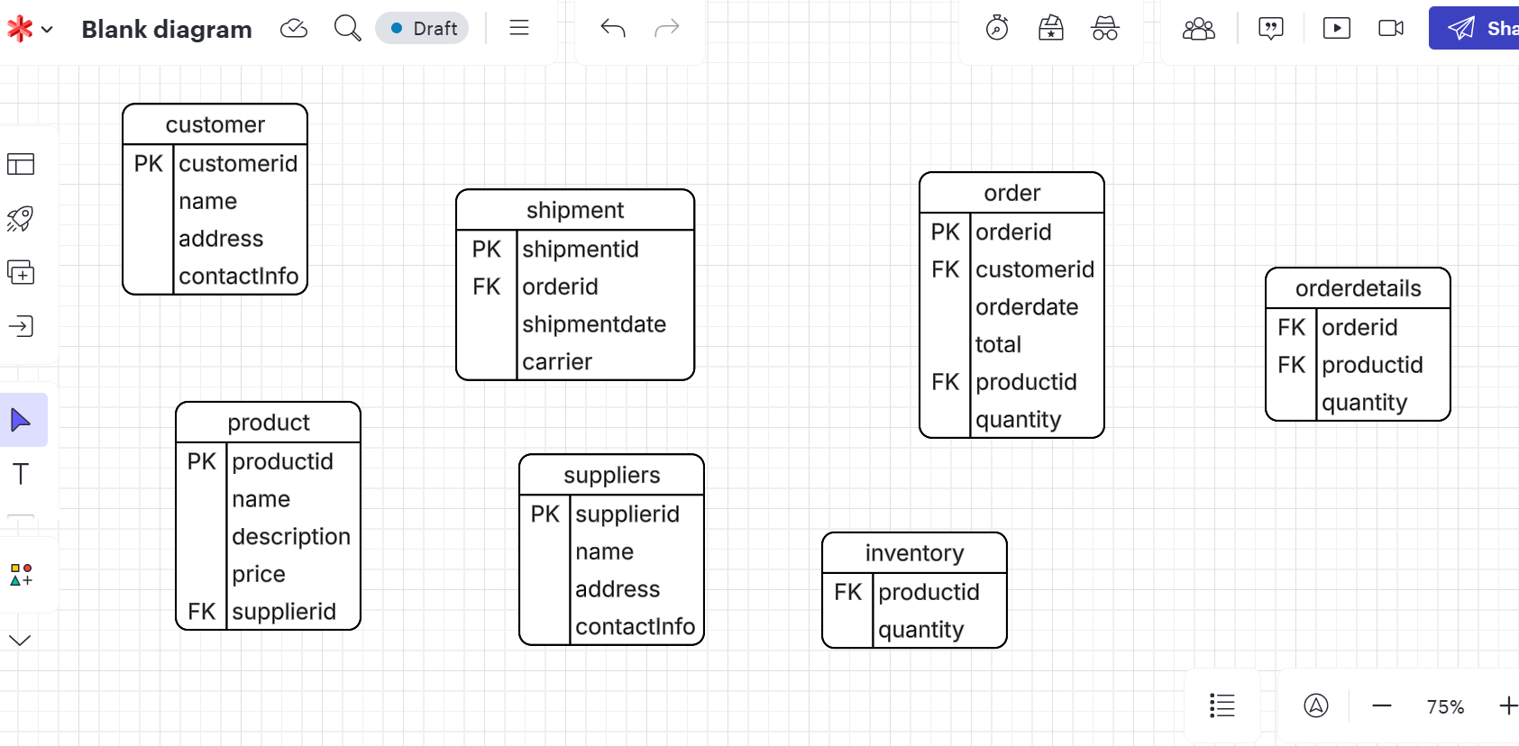
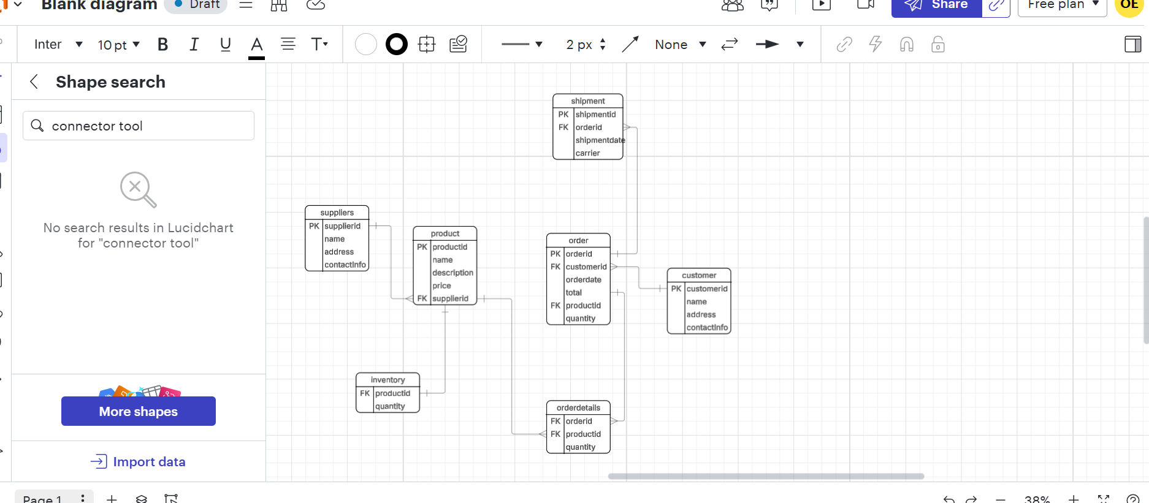
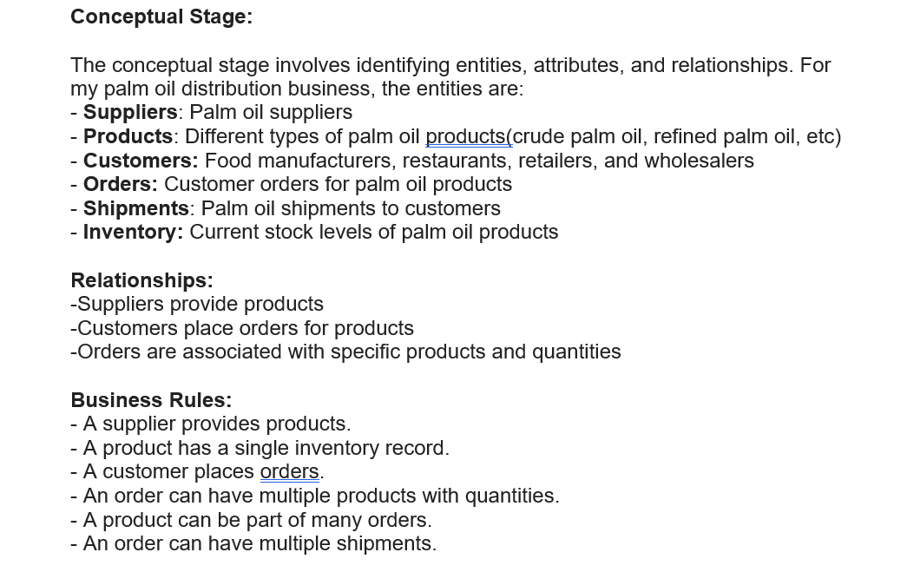
Screenshots of ERD, Database Design On MySQL Workbench, Technical Writing

Slide 6
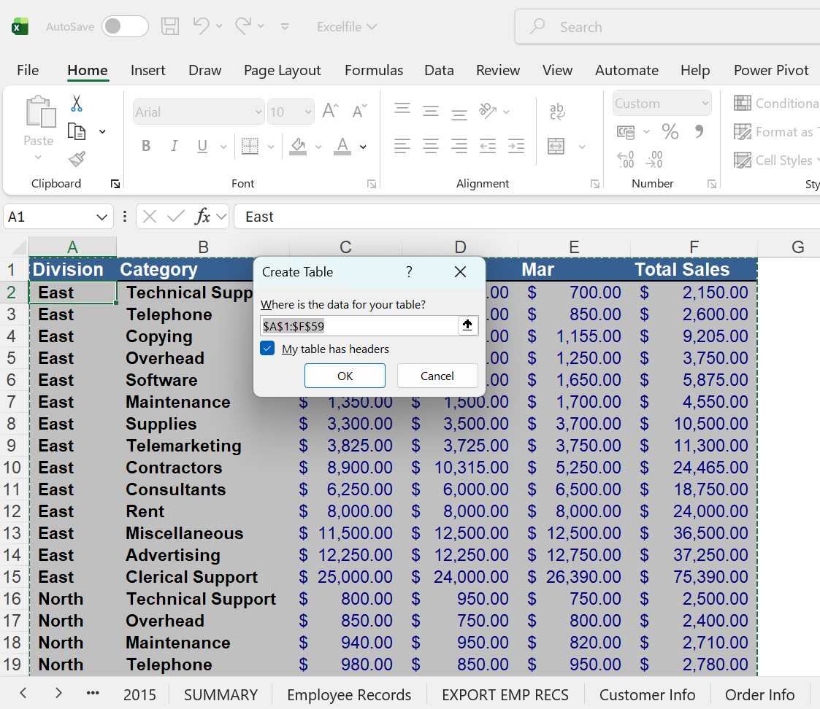
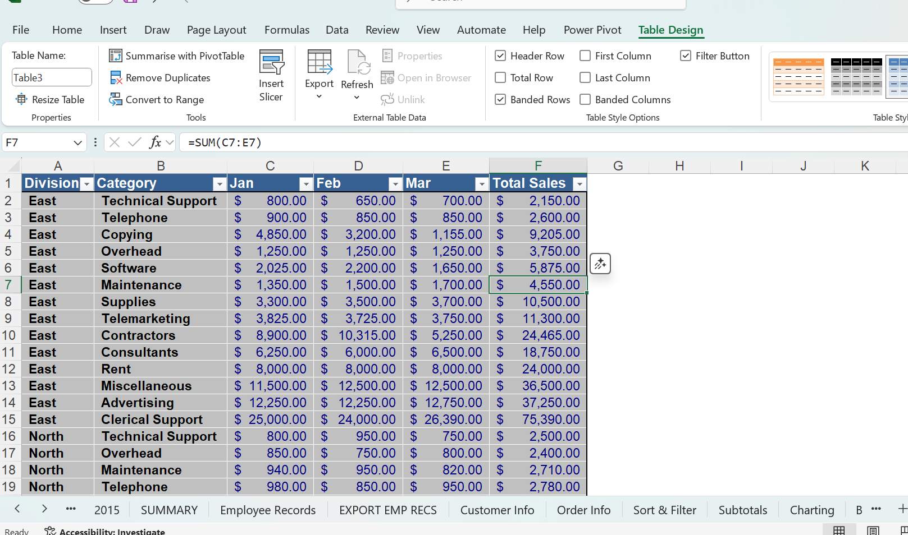
Excel Learning Objectives
Excel Skills Acquired
Bullet points:
Converting range to Table by using Ctrl + T
Converting tables to ranges
Using Paste Values to override formulas
Highlighting and deleting duplicate rows
Data validation
Calculating subtotal by groups
Sorting and filtering data
Creating charts from tables

Slide 7
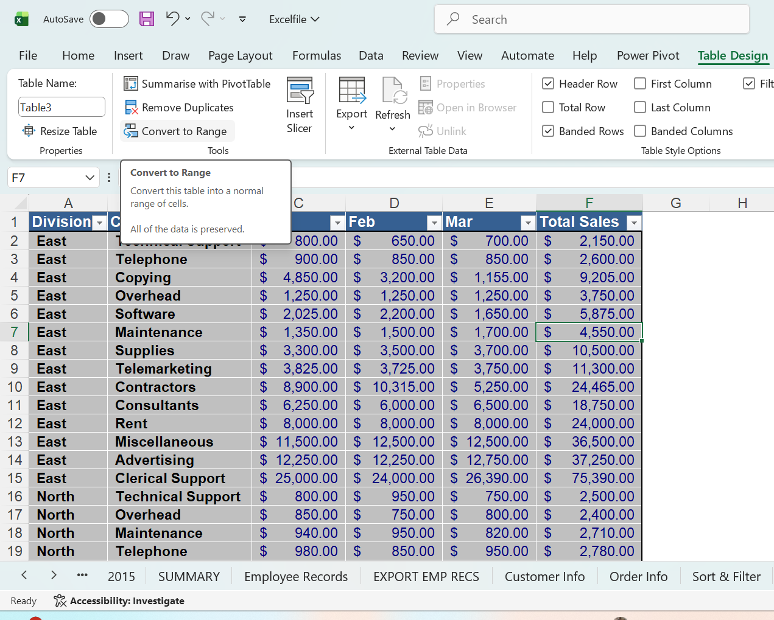
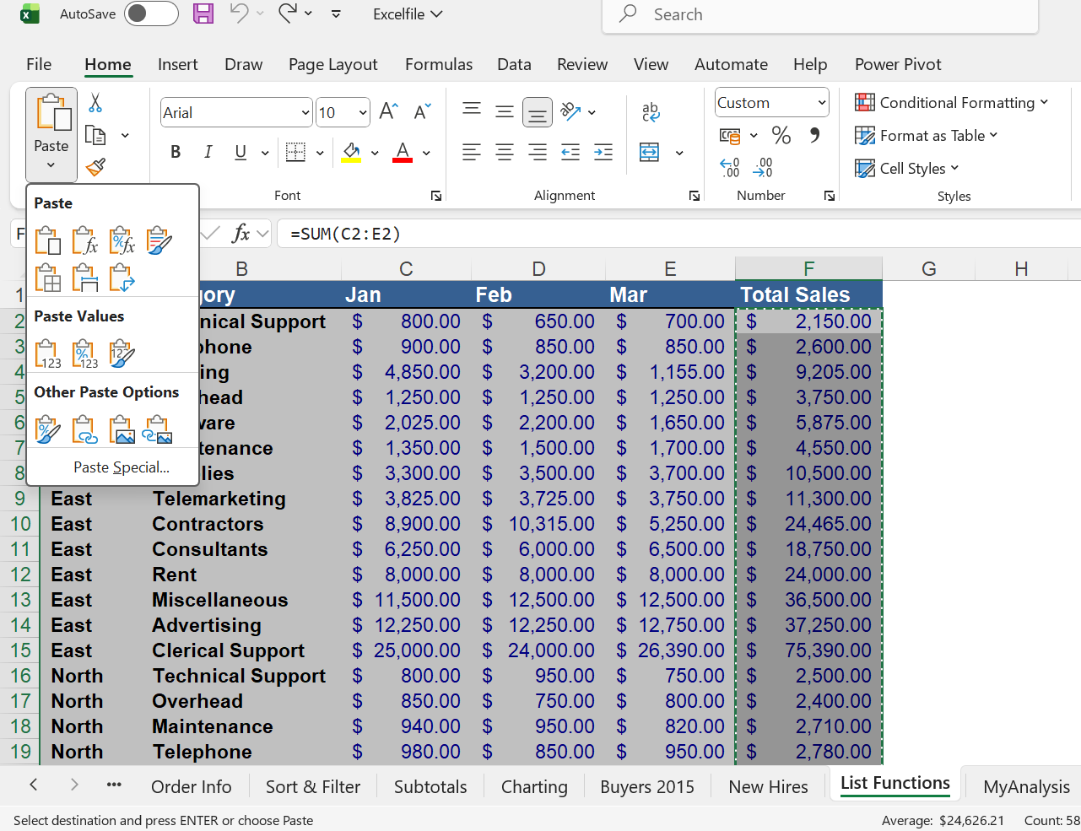
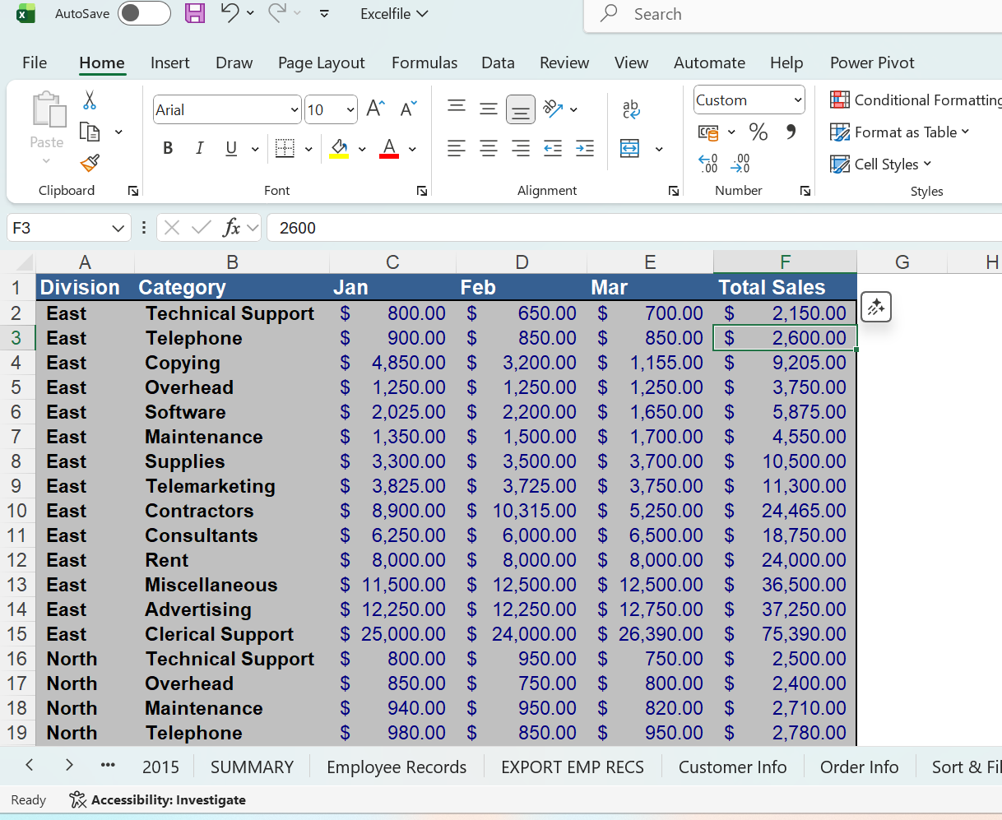
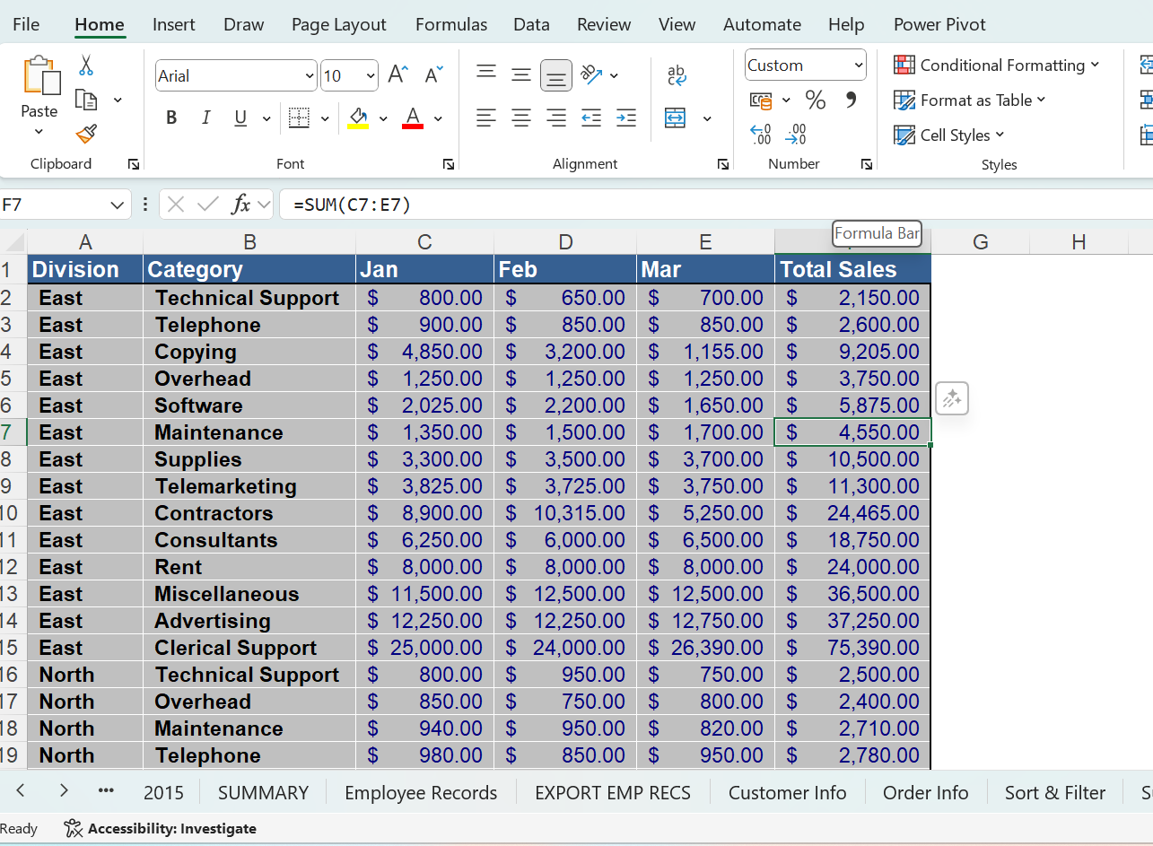
Converting Table to Range and Replacing Formular with Values

Slide 8
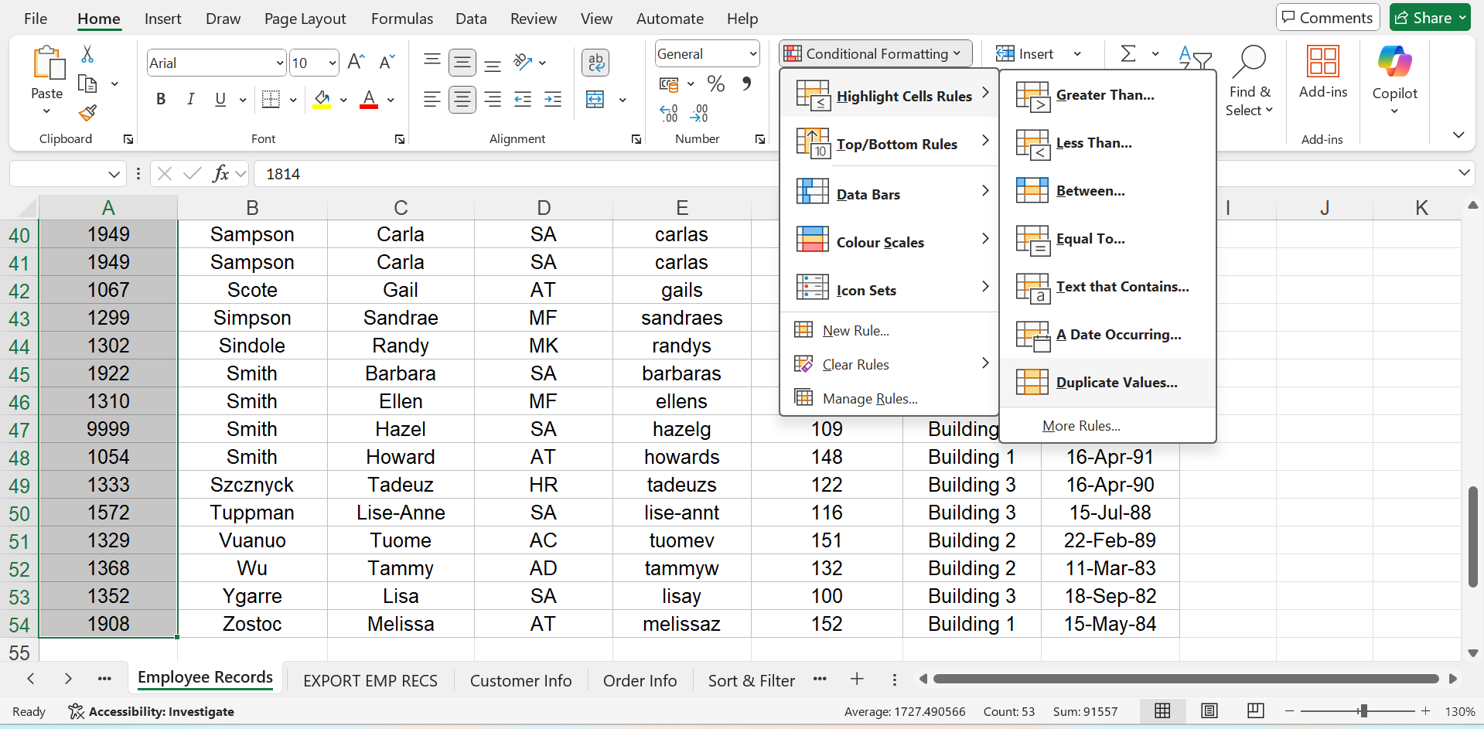
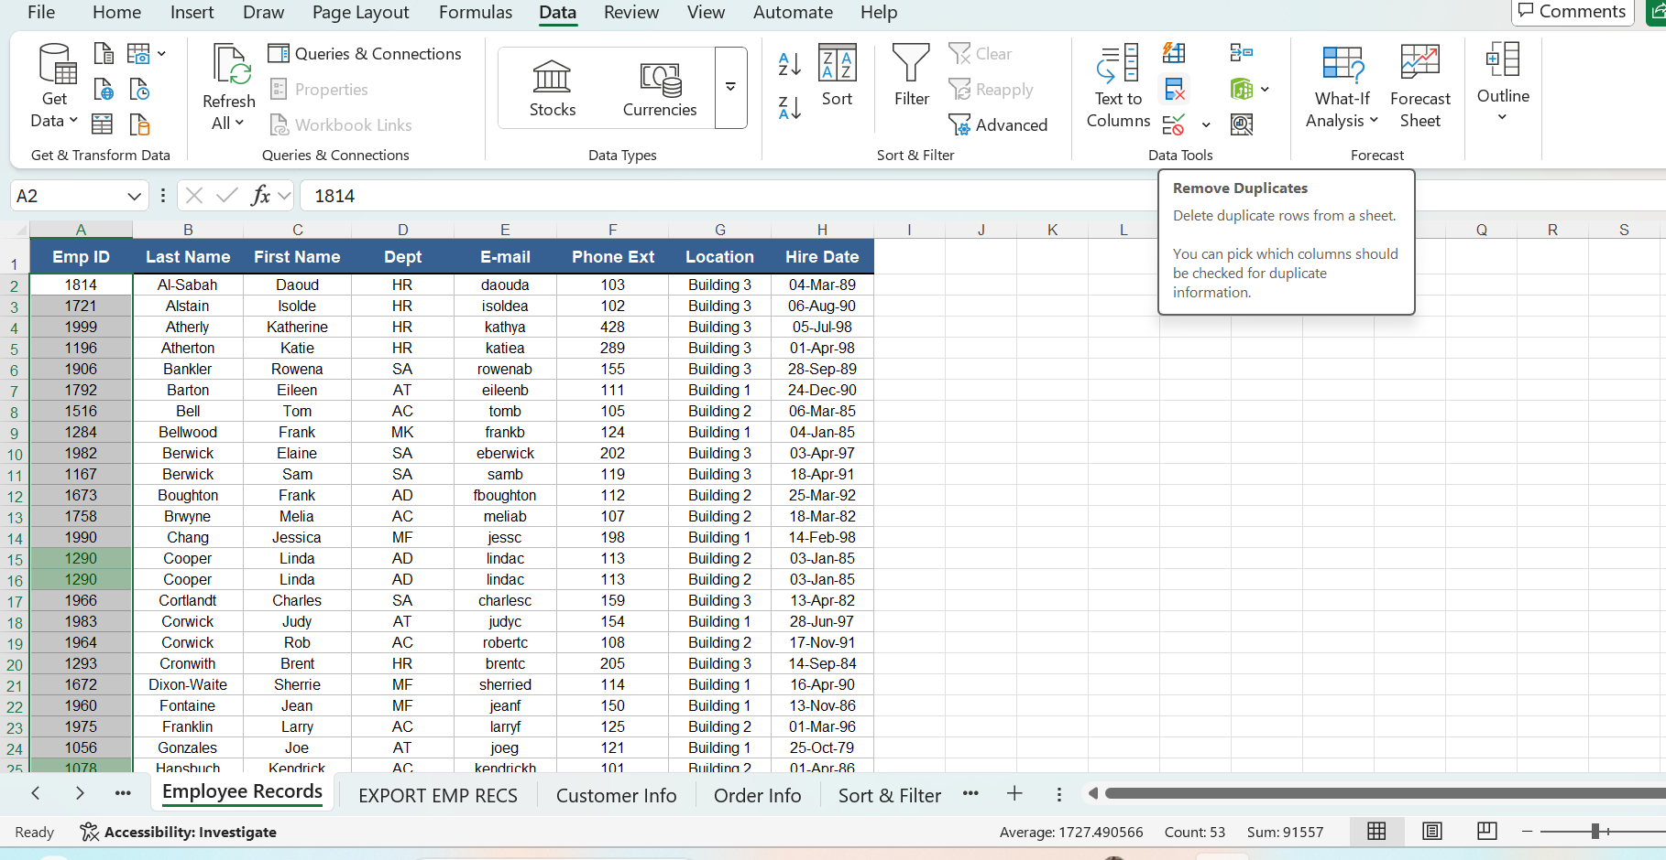
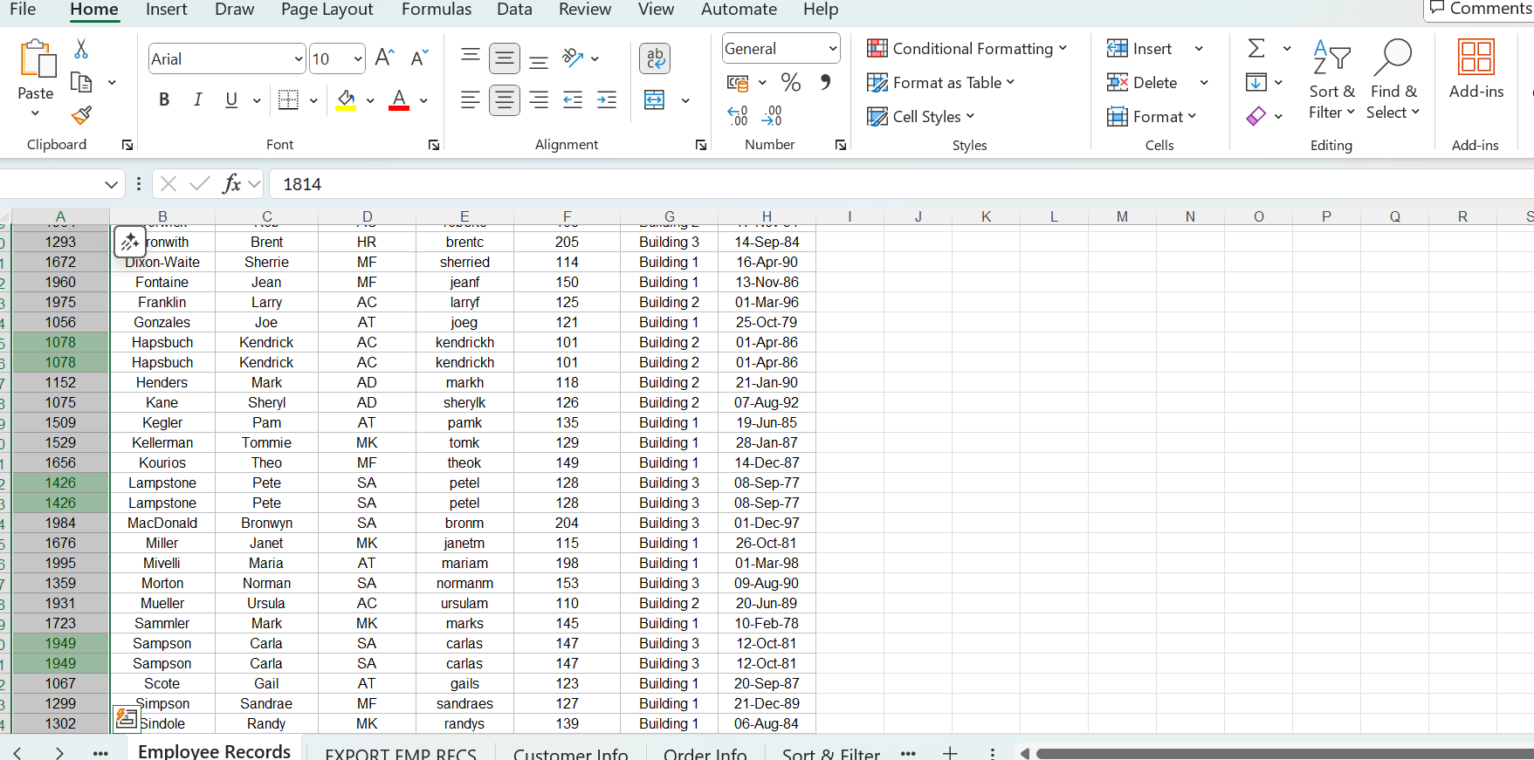
Highlighting and Deleting Duplicates Rows

Slide 9
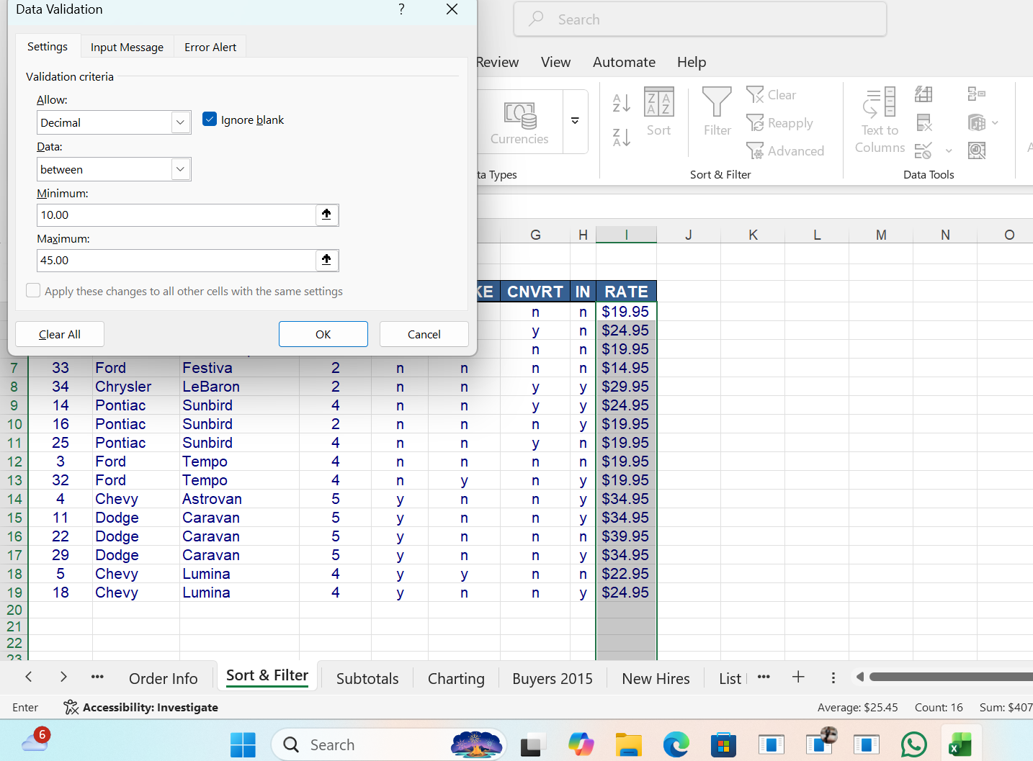
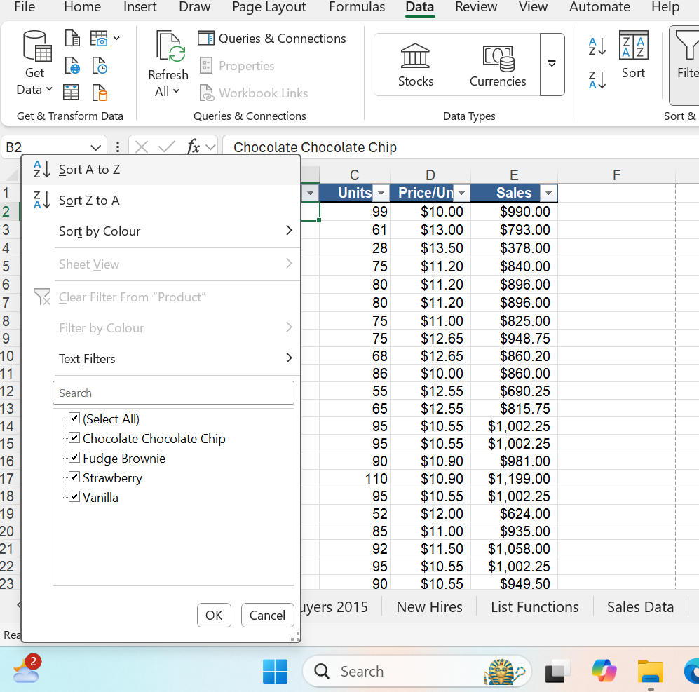
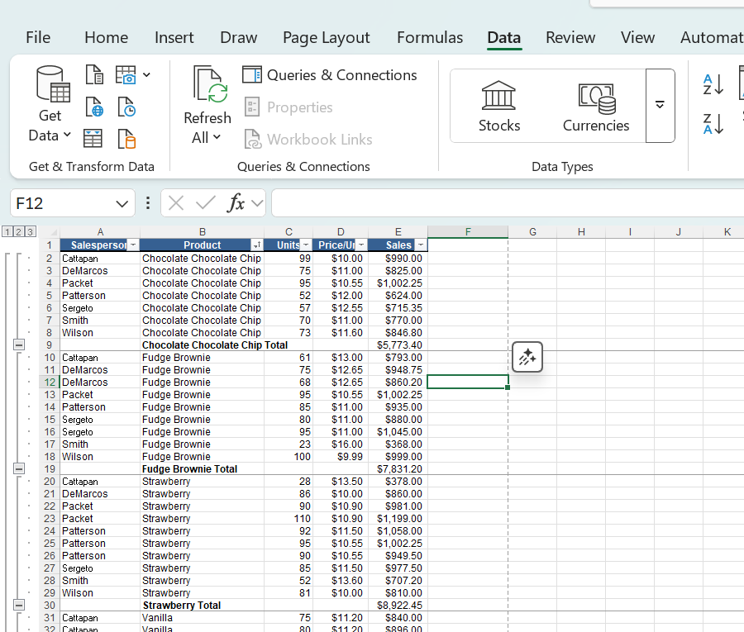
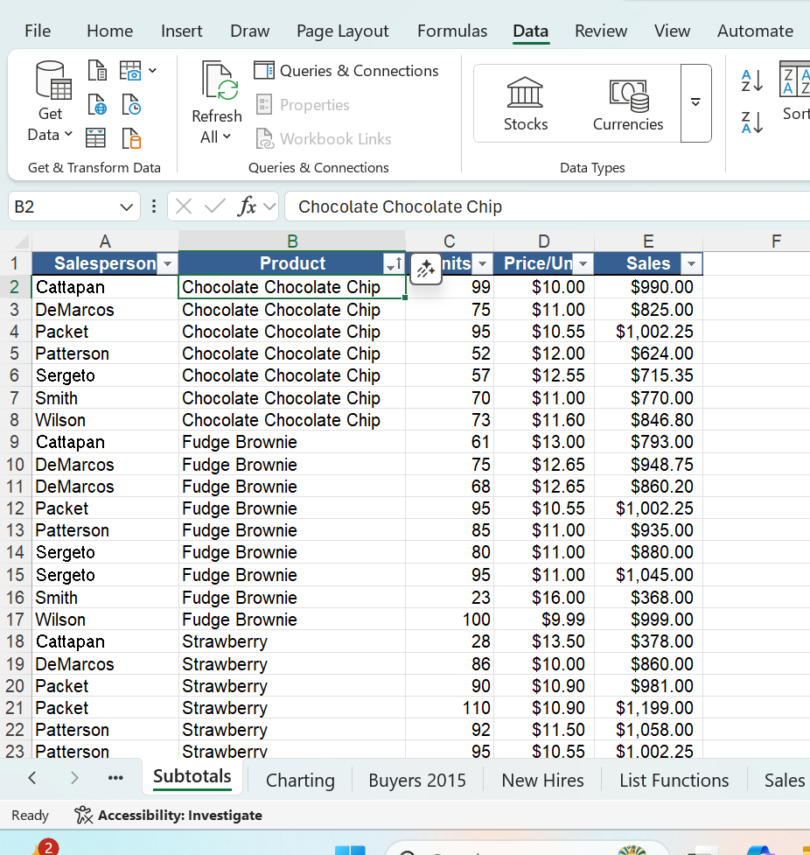
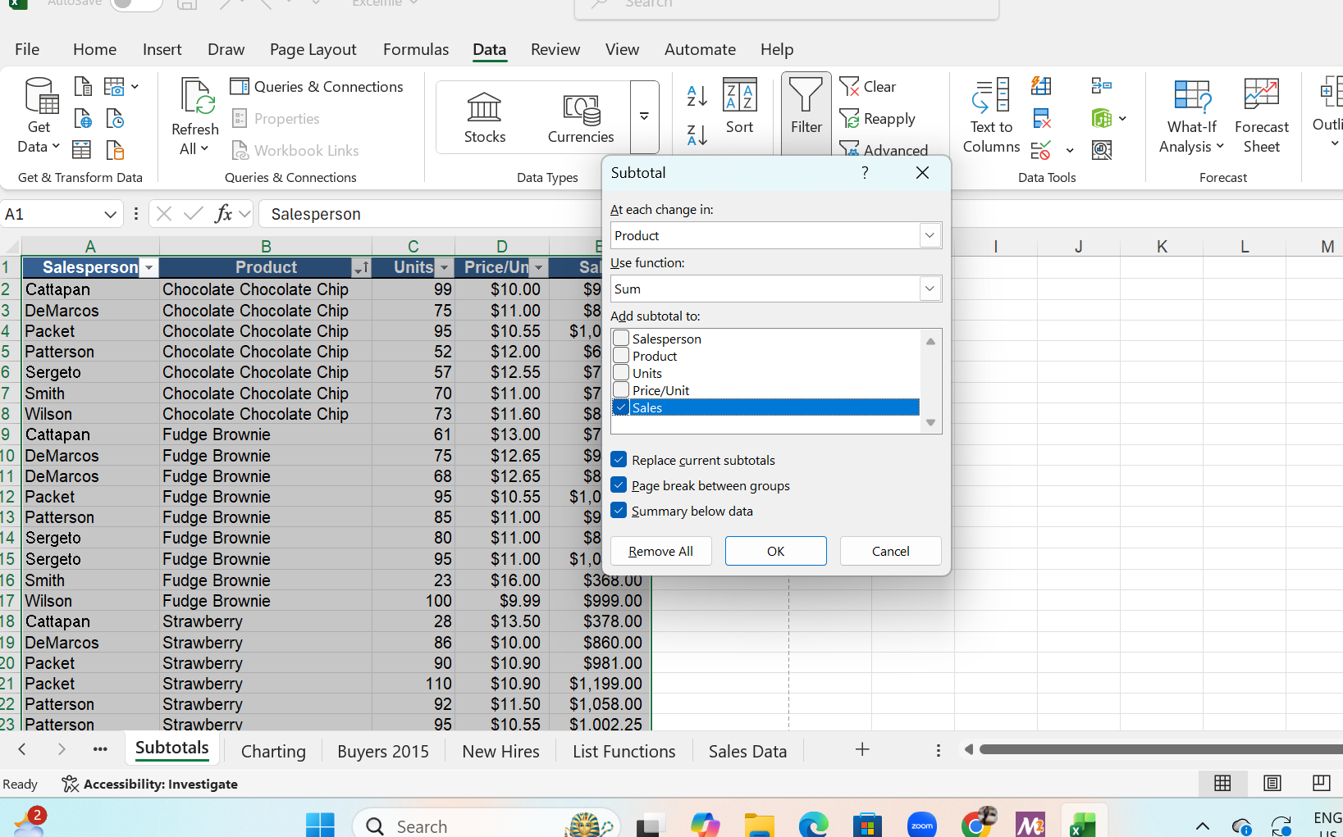
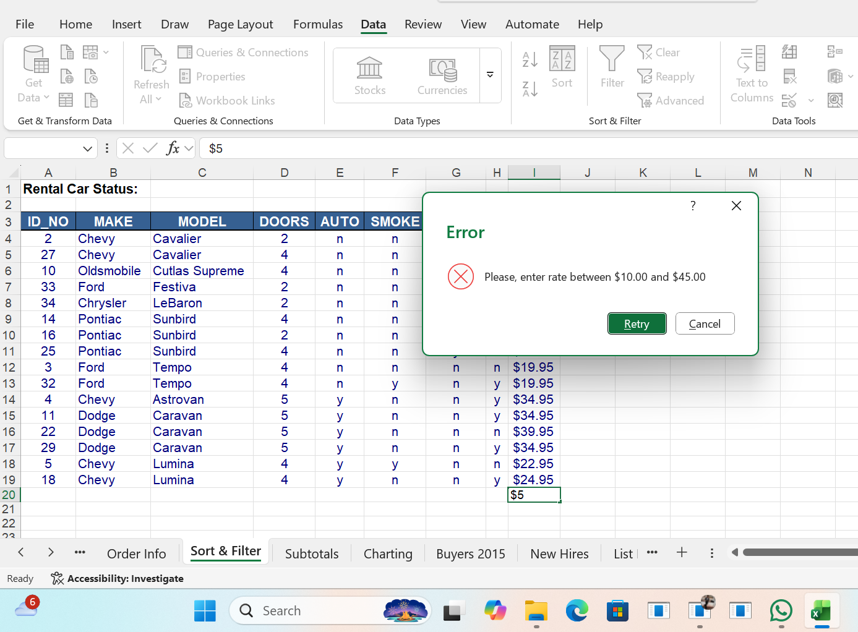
Screenshots of Data Validation, Sorting, and Calculating Sub Totals By Group

Slide 10
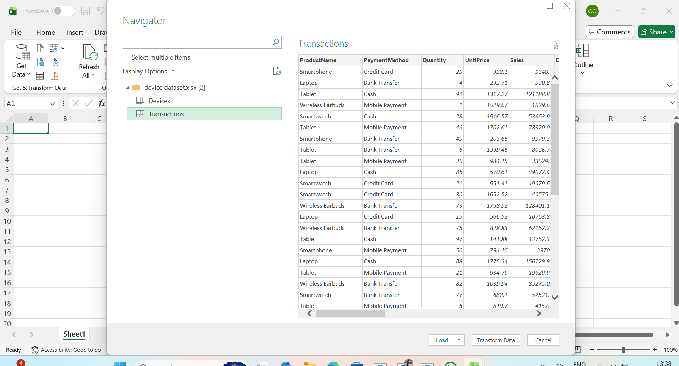
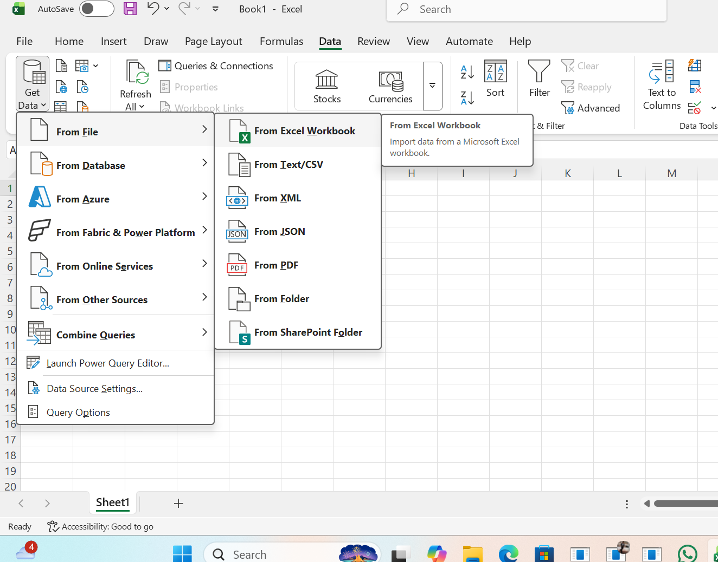
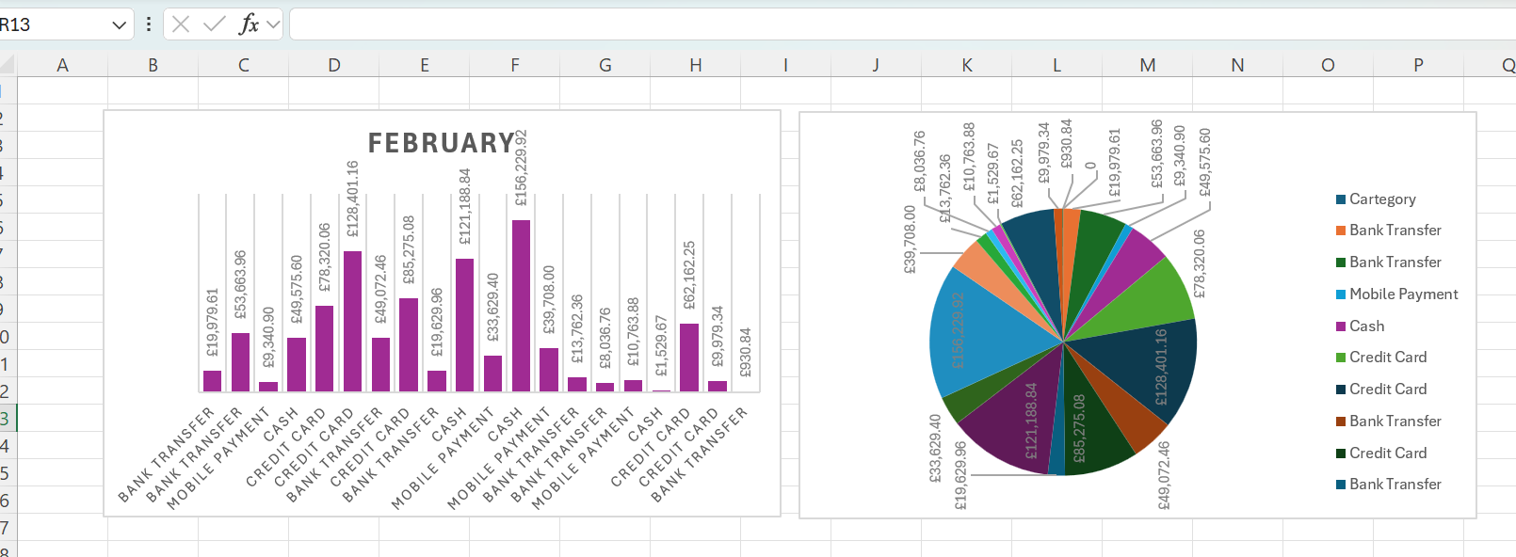
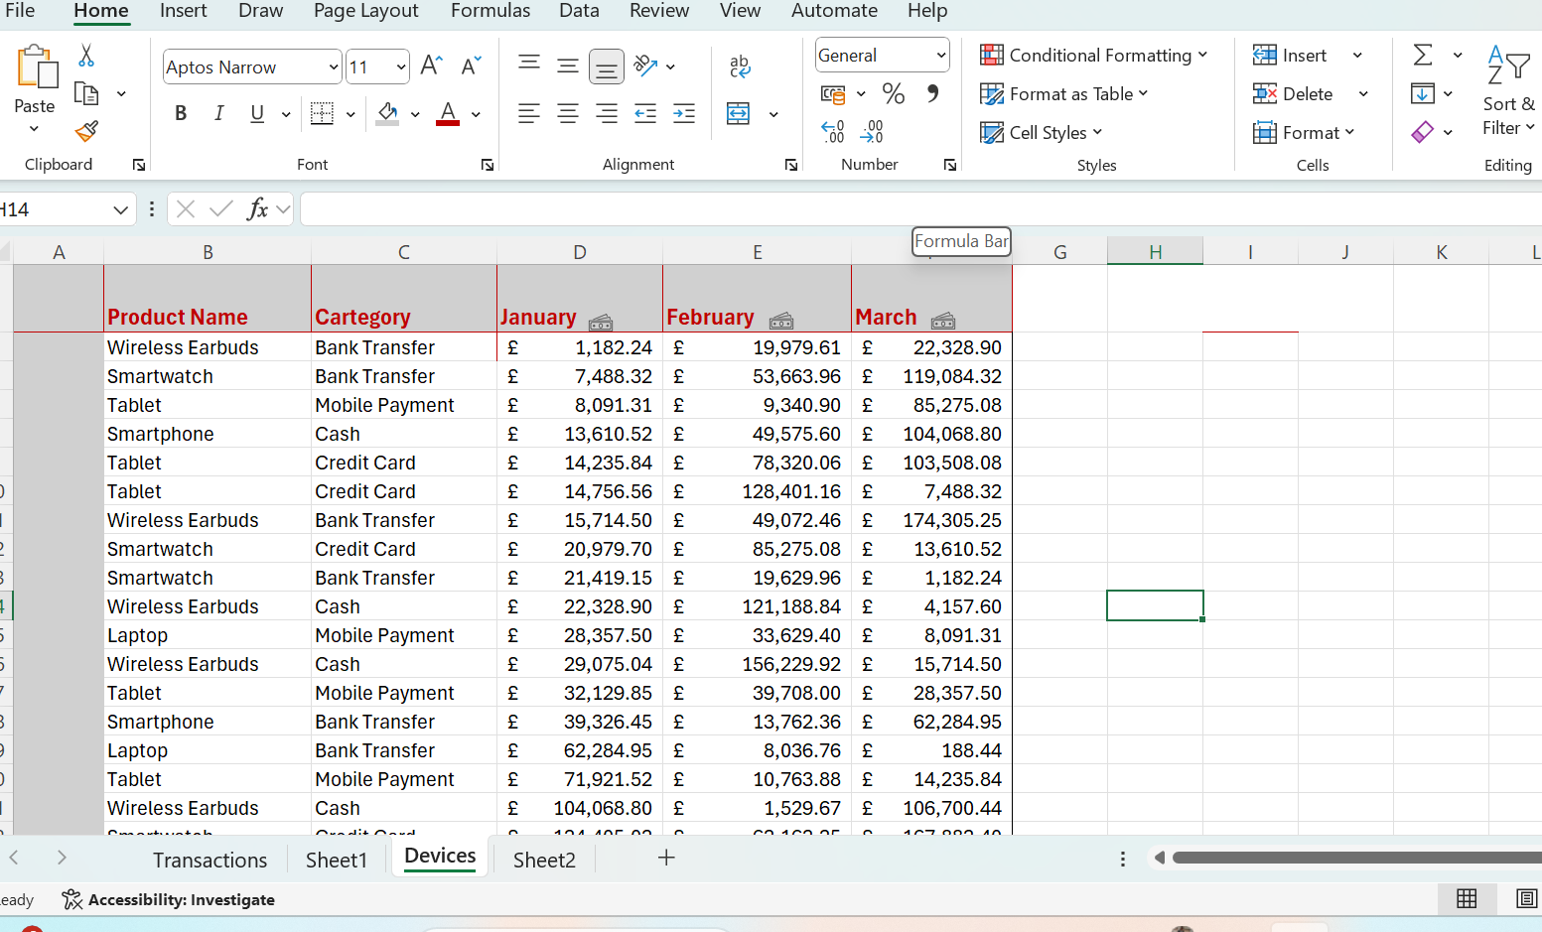
Screenshots of Importing Data To Excel
And Creating Charts In Excel Sheets

Slide 11
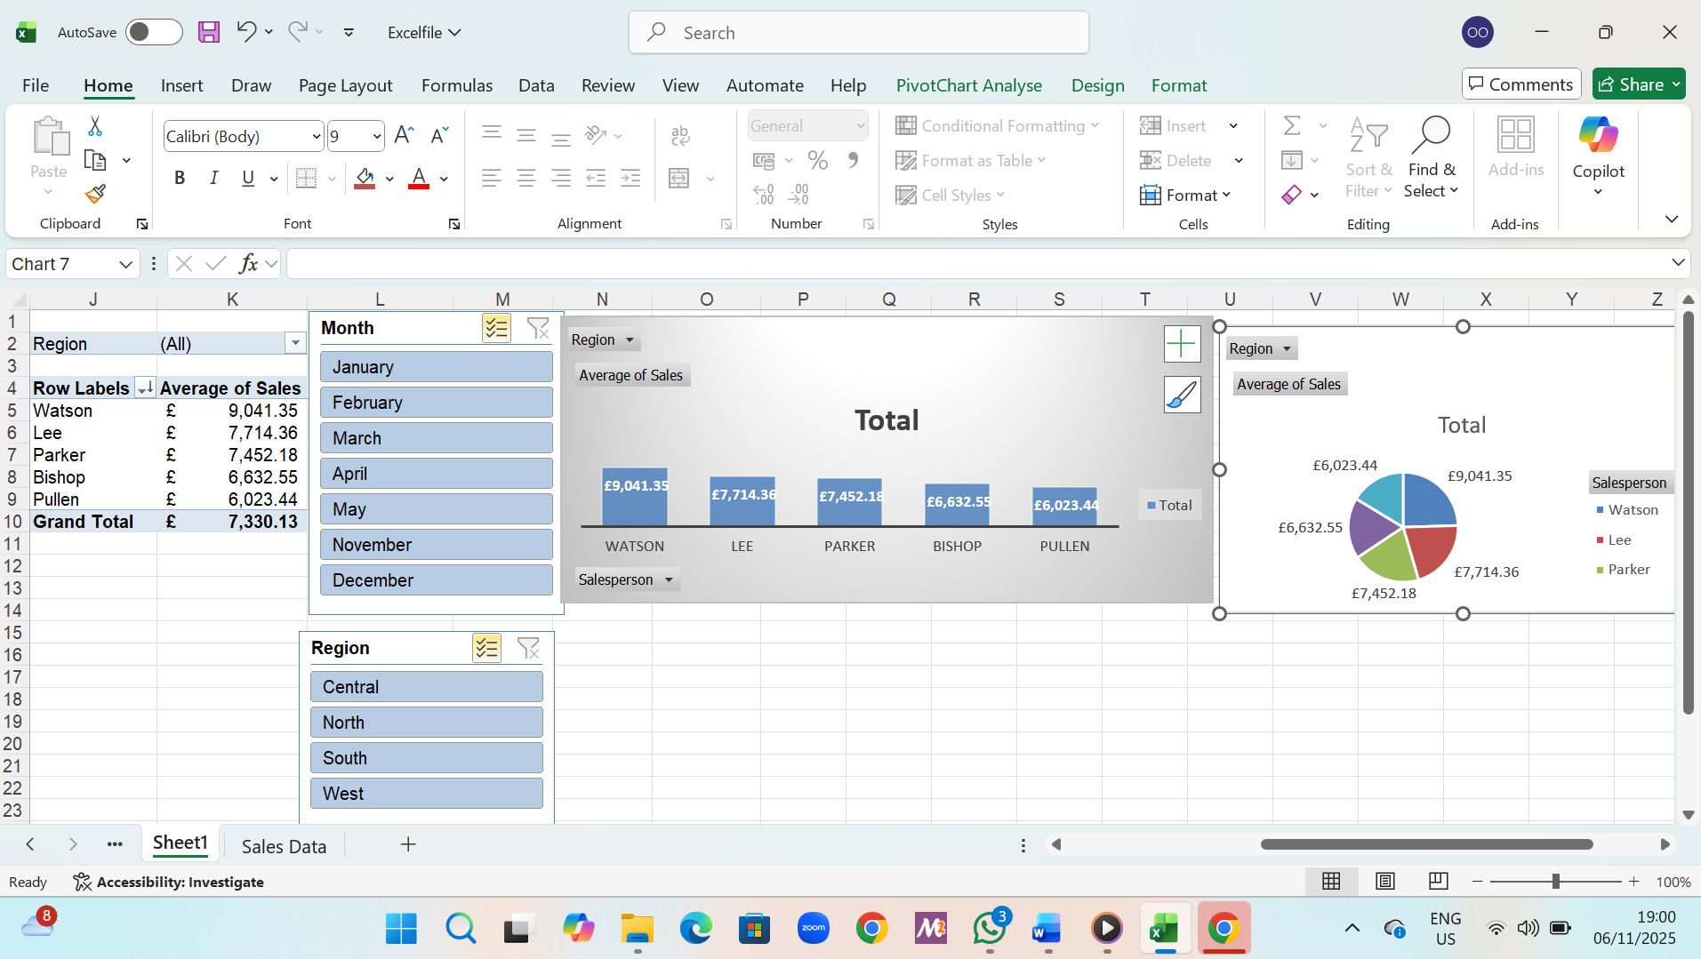
Creating And Analyzing Pivot Table
Pivot Table Best Practices
Bullet points:
Ensure column names/headers are present
Format columns correctly (numbers, accounting, general/text)
Remove empty rows and aggregation
Check for duplicates
Creating Pivot Tables

Slide 12
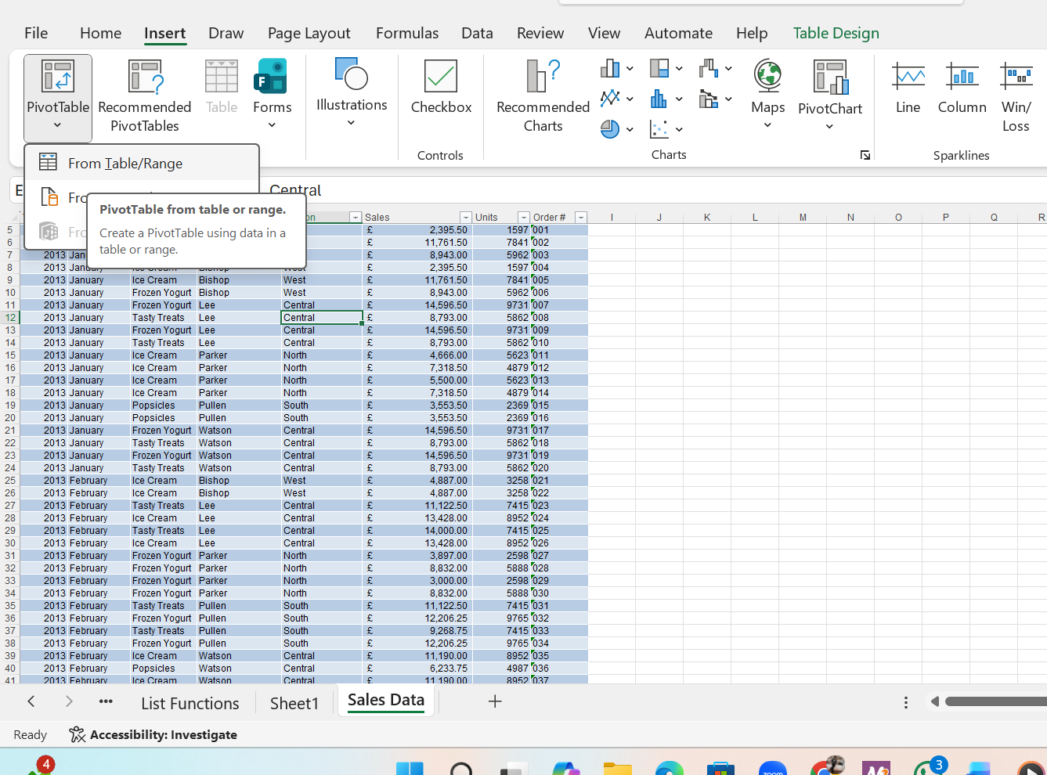
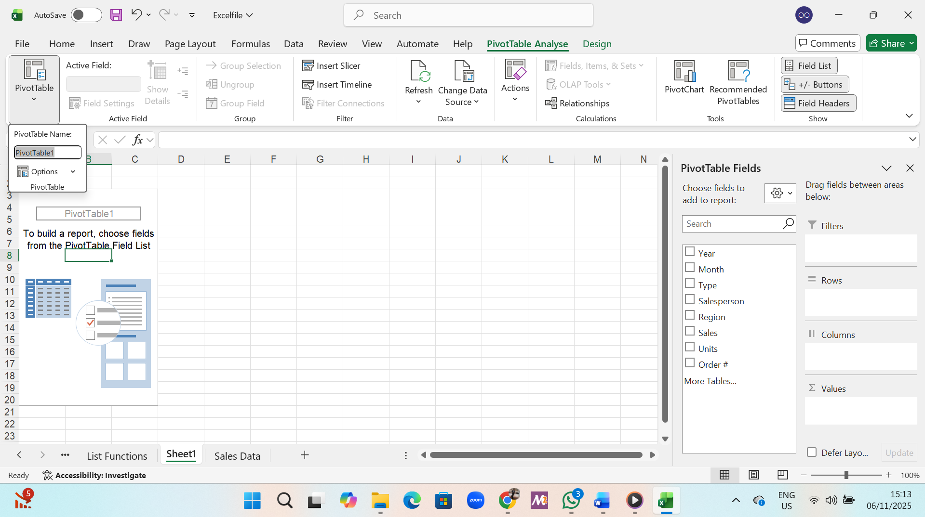
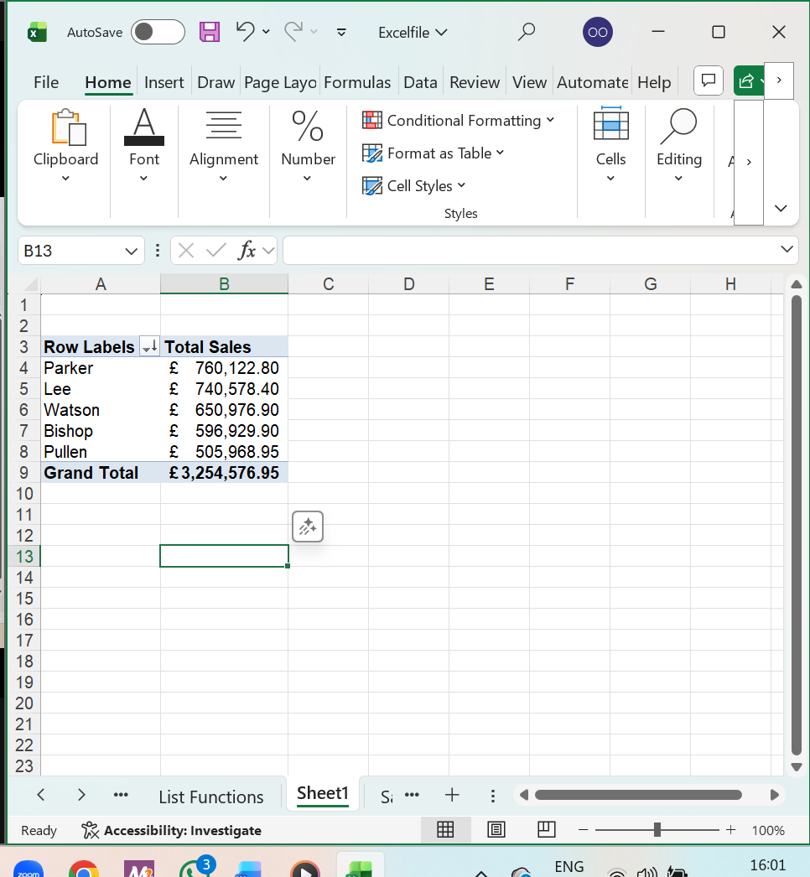
Screenshots of Creating Pivot Table From Tables

Slide 13
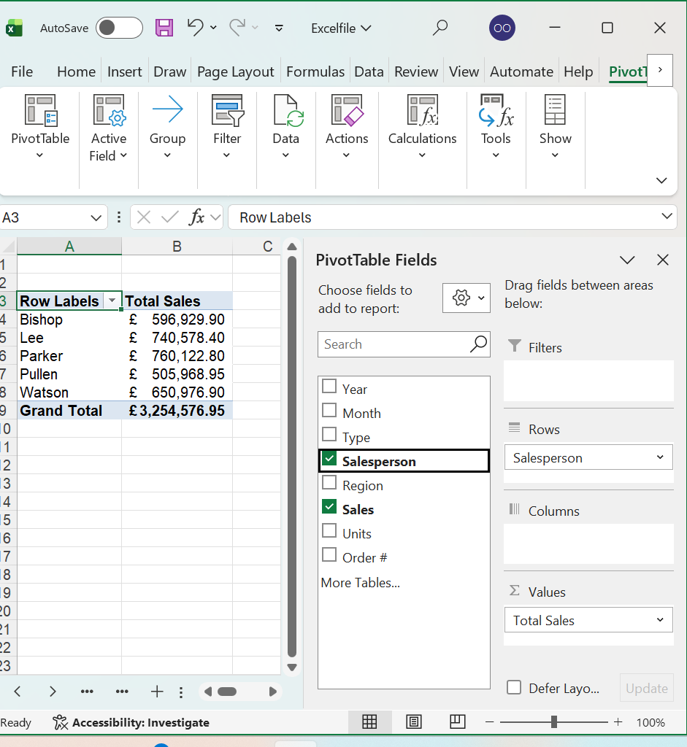
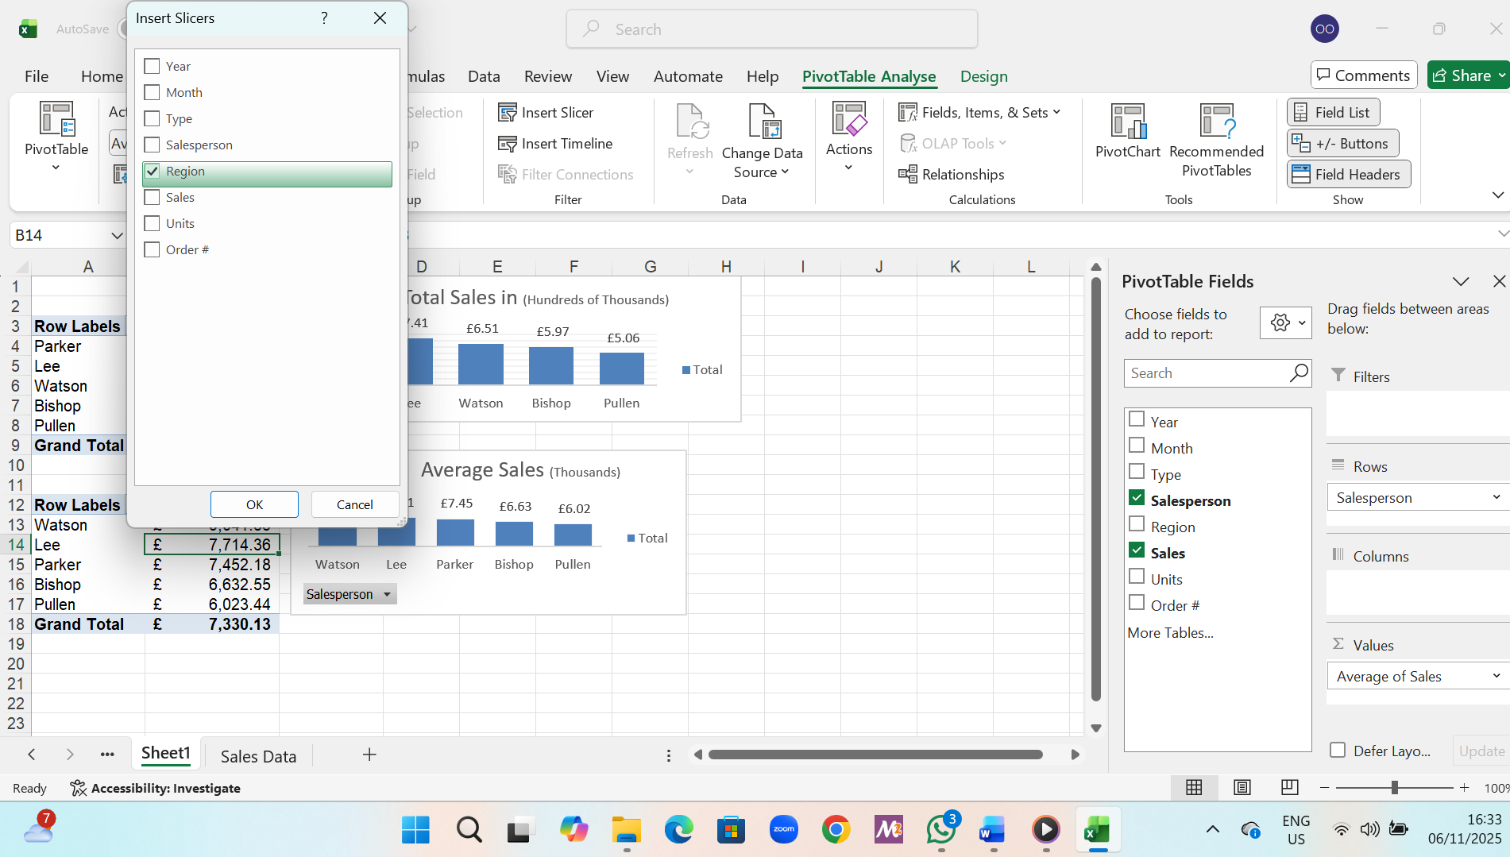
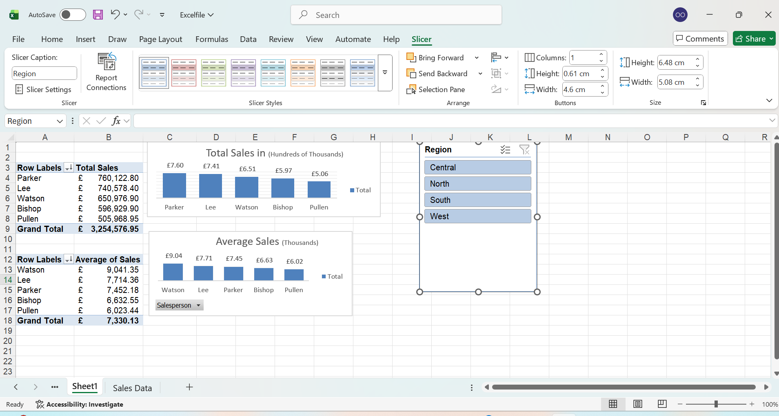
Screenshots of Pivot Table Analysis

Slide 14
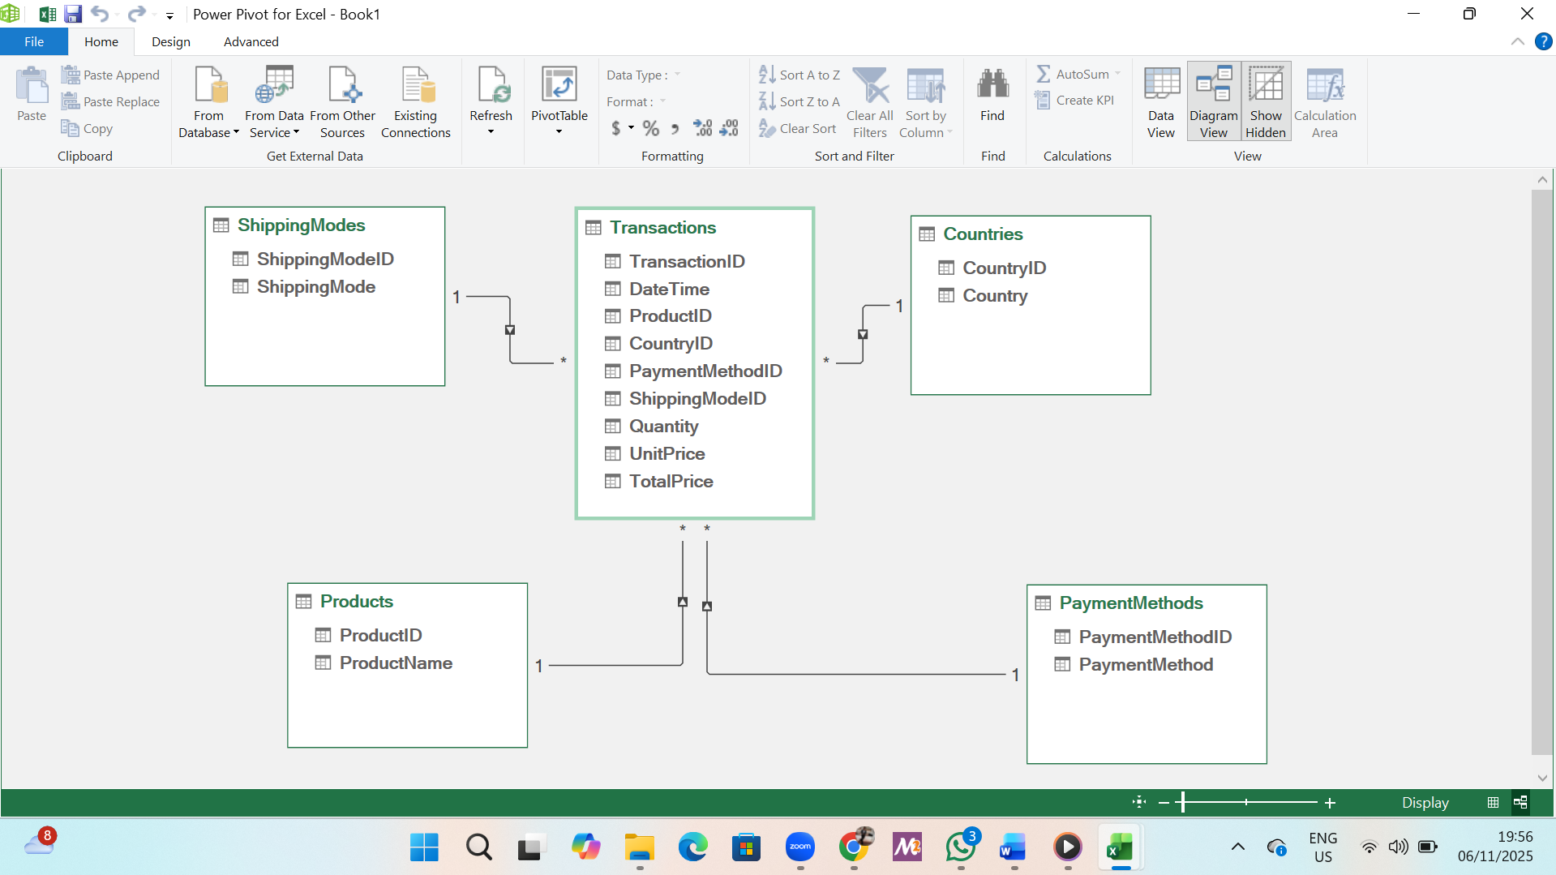
Power Pivot and ERD
Power Pivot and ERD Design
Bullet points:
Enabling Excel Power Pivot
Importing data from datasets
Designing ERD on Power Pivot

Slide 15
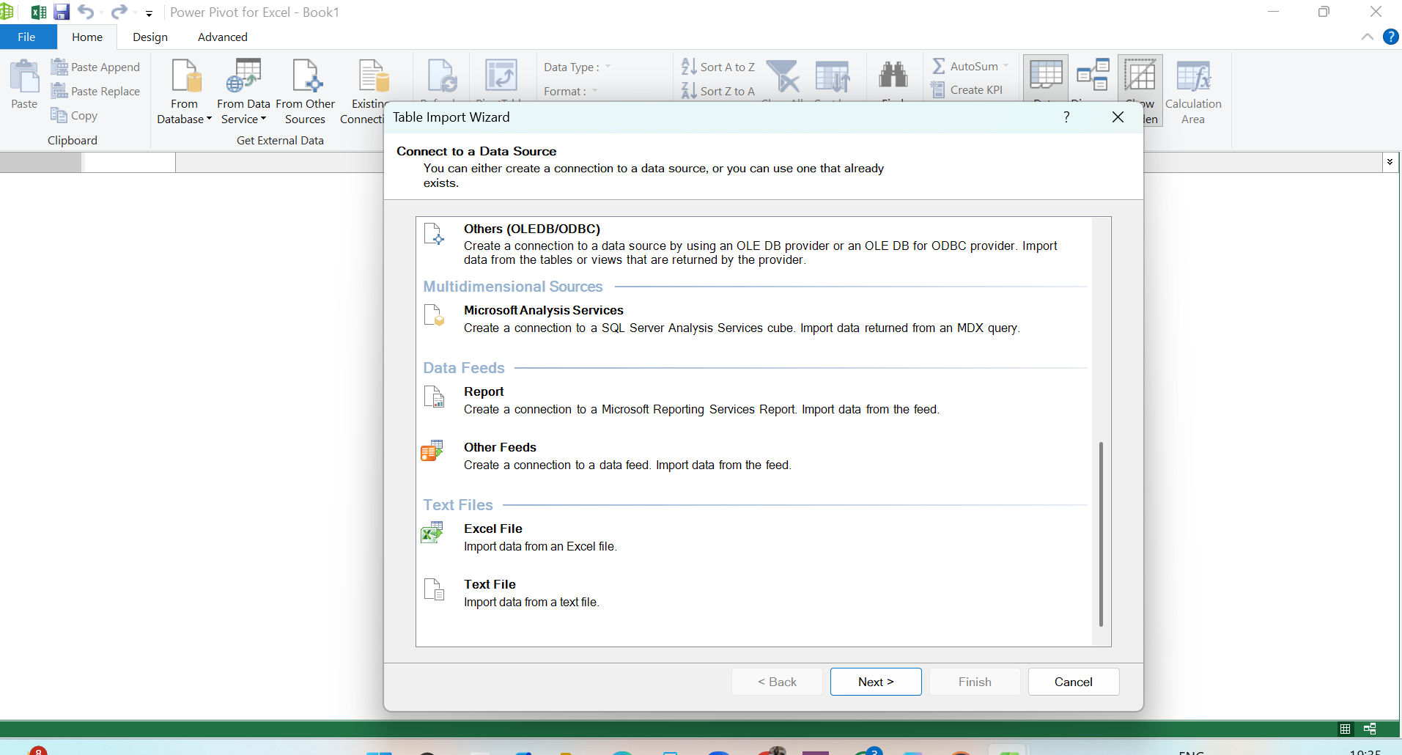
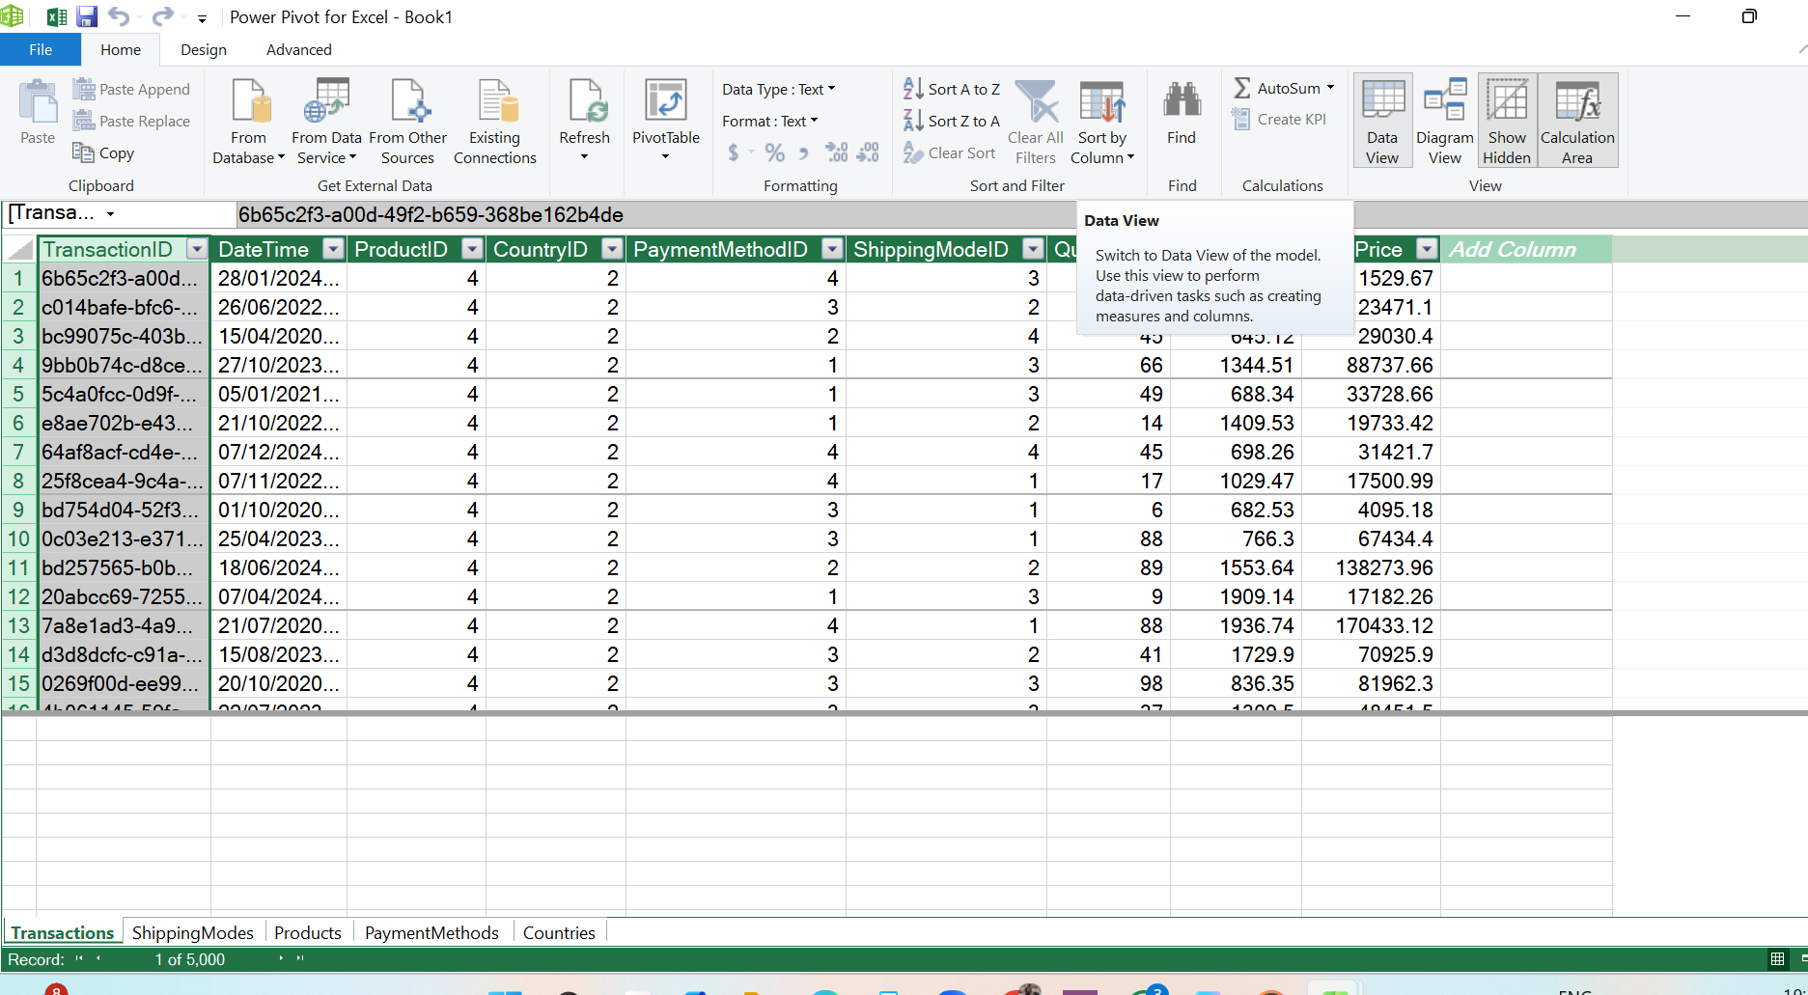
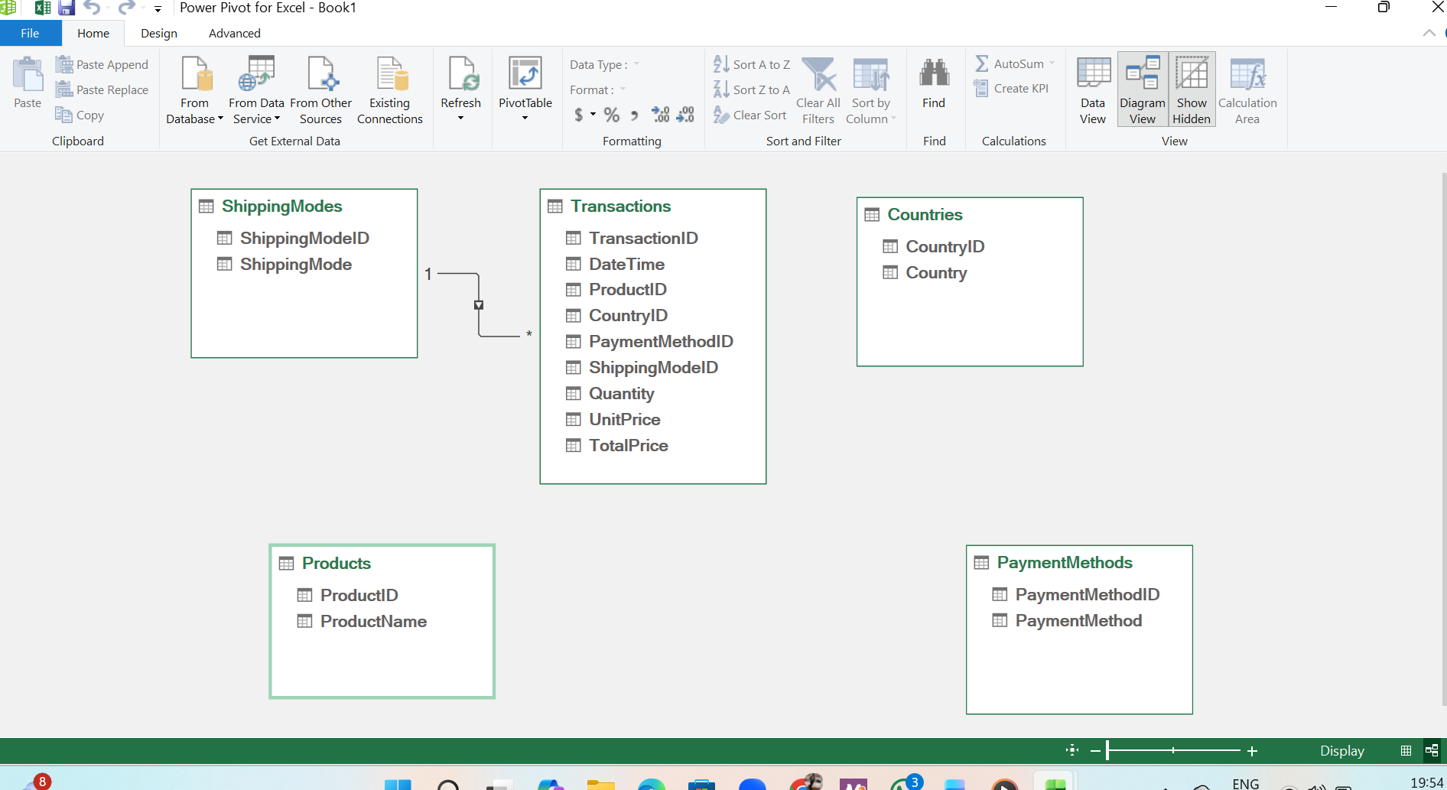
Importing Data to Excel Power Pivot And Creating Relationships

Slide 16
Conclusion
Summary of what I learnt over the past four weeks:
Database Design: Palm oil database design
Azure DevOps: Project management, collaboration
Excel: Dynamic ranges, pivot tables, charts
Thank You For Listening

